Slide 1
Lepton Software
A strategic tool for location planning
Location Intelligence is the new Business Intelligence!

Slide 3
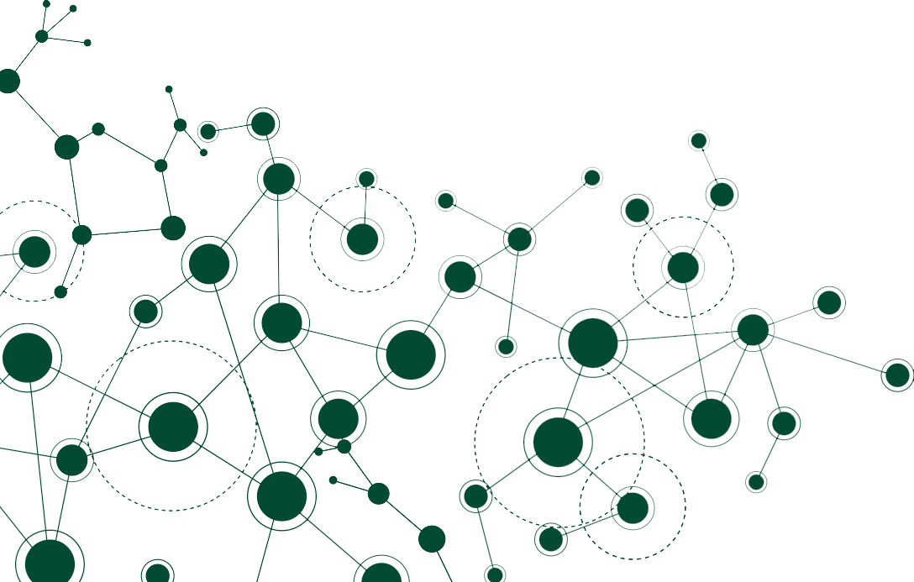
YOUR DIGITAL JOURNEY
BEGINS HERE
A strategic tool for location planning
Lepton Software Overview
NetworkAccess
rfMAP
SmartMarket & SmartData
Copyright 2019 | Lepton Software

Slide 4
Overview
More than
Serving
More than
25
8+
200
Years
Industries
Leader in Location Intelligence & Analytics
Like FMCG, Retail, Automotive, Telecom, Banking, etc.
Data Analysts, Data Engineers, and GIS specialists
Authorized Partner
Authorized Partner
Strategic Partner
Copyright 2019 | Lepton Software

Slide 5
As Featured in
JAPACs Fastest Growing Company for Google Maps
Best Location Intelligence Partner of the Year for Telecom Vertical in Asia
Key vendor in the global design and engineering space
Top Five Product Companies at NASSCOM Product Conclave- North
Adjudged top 20 IT companies in India by CIO review
Overall Best IT Project of the Year for Unified GIS Project of Bharti Airtel
Copyright 2019 | Lepton Software
5

Slide 6
Industries We Cater to
Telecommunications
Banking & Finance
FMCG & Retail
Automotive
Logistics
Government
Insurance
Travel
Copyright 2019 | Lepton Software

Slide 7
Clients Served
Copyright 2019 | Lepton Software

Slide 8
Our Products
Network Access
rFMap & 3DMap
Smart
Market
Smart Data
Highly visual GIS based telecom network inventory and analytics platform for both wireless and wireline
2D and 3D maps for wireless network planning, RF network planning and optimization.
Location intelligence platform to make informed planning, business expansion and operations optimization
Analyse business using map data like demographics, economic activity, POI spread etc.
Copyright 2019 | Lepton Software

Slide 9
Our Partners
Lepton Software is a premier Google Maps partner in the JAPAC region and the largest map partner in India. We resell Google Map API licenses and provide content to Google Maps.
Lepton Software is the premier Google Cloud reseller and partner in India. Lepton develops applications for organisations on cloud using the AI & ML technology.
Lepton Software is an authorized Pitney Bowes partner since 2005. We resell Spectrum (ETL), MapInfo, MapXtreme.
Lepton is an authorised InfoVista partner since 2006. Lepton resells InfoVistas products Mentum and Ellipse.
Copyright 2019 | Lepton Software

Slide 10
NetworkAccess©
A strategic tool for location planning
Design . Build . Operate . Monetize

Slide 11
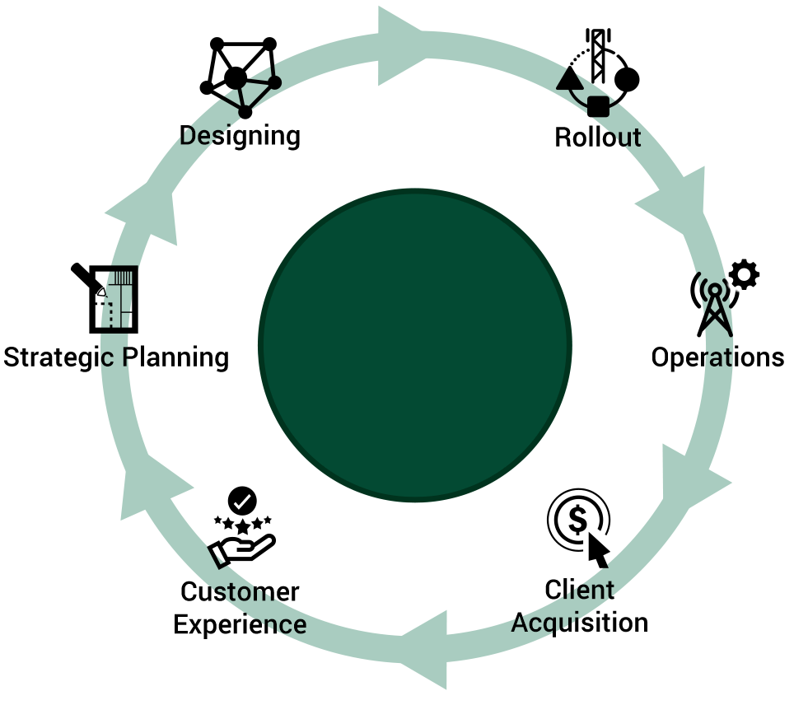
Design to Cash
SmartLocator
Customer Experience
Network Lifecycle
Management
with
NetworkAccess©
SmartFeasibility
Client Acquisition
SmartTrack
Operations
SmartInventory
Rollout
SmartPlanner
Strategic Planning
& Designing
Copyright 2019 | Lepton Software

Slide 12
Deployment Footprint
Deployed in
Serving
Subscribers
450 million
4 Countries
4
144
15
Access Technologies
Million km
Million
GPON, IP/MPLS, Cellular, Active Ethernet
Fiber
Assets
More than 60% Market Share in Deployment in India
Copyright 2019 | Lepton Software
12

Slide 13
Outcomes
80%
25%
Improvement
Reduction in Survey
for
Fiber Feasibility
30%
in Inventory Utilization
Improvement
65%
in Field Force Productivity
90%
Reduction in Saving of Efforts and Time for Planning FTTX Network
Increase in
Customer
Satisfaction
Most Digital Journeys with Power of ONE, Multiplied into Many
Copyright 2019 | Lepton Software
13

Slide 14
NetworkAccess Attributes
OPEN AND EXTENSIBLE
MULTI-TECH
MULTI-VENDOR
OUTCOME BASED
Standards based
Maximizes Sales
Interoperable
Optimizes CAPEX
Layered
Enhances Customer Experience
Copyright 2019 | Lepton Software
14

Slide 15
rfMAP ©
A strategic tool for location planning
High Precision 2D/3D GeoData for the Planet

Slide 16
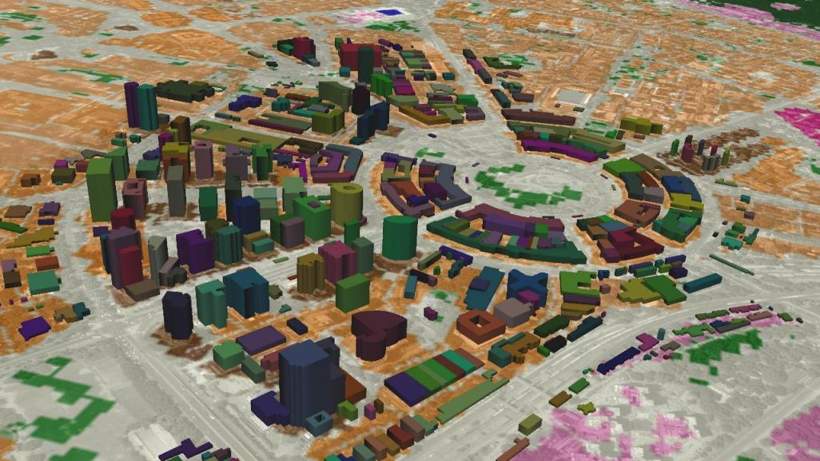
rfMAP
Goal: To help telecom companies check feasibility and planning for network expansion
Impact: Faster and more accurate RF planning and significant cost reduction
Solution: High-quality geographic data for wireless RF network & wired telecom networks
Copyright 2019 | Lepton Software

Slide 17
Components of rfMAP©
DTM
Clutter
Road Vectors
Population Map
3D Map Dataset
Stereo imagery and topographic maps generated terrain database
High resolution satellite imagery updated clutter data classified into 12-25 classes
Street level road & rail network created & updated from latest high resolution satellite imagery
Highly accurate projected population dataset sourced from local Census Agency
High resolution stereo imagery generated 3D Map dataset with 1m accuracy
Copyright 2019 | Lepton Software

Slide 18
rfMAP
Maps for Network Planning & Optimization
Global Coverage
Maps available from 1m to 100m resolution including 3D maps
Only company providing integrated network planning & optimization services from geodata to network rollout.
Deep understanding of different geodata requirements for different wireless applications - 2G, 3G, LTE, WiMax & CDMA.
Large field force to create more accurate geodata.
Strong in-house R&D capabilities.
On global vendor list of major equipment suppliers.
Mapped more than 150+ countries and 1500+ cities
Compatible with all planning tools
Recognized industry leader, and preferred vendor for leading equipment vendors
Copyright 2019 | Lepton Software

Slide 19
SmartMarket
A strategic tool for location planning
Capture the future market today

Slide 20
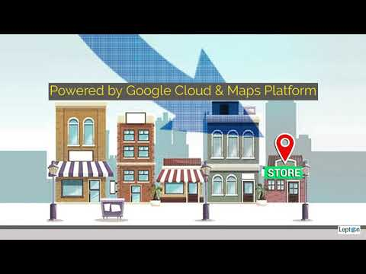
Why organisation on high growth path use location intelligence?
Copyright 2019 | Lepton Software

Slide 21
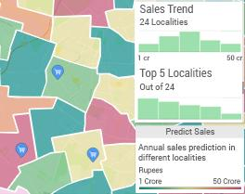
SmartMarket - Analysis & Approach
Identify area-wise potential through data points and sharpened analytics.
Build models to predict sales in predefined areas.
Ability to review current business with potential.
Copyright 2019 | Lepton Software

Slide 22
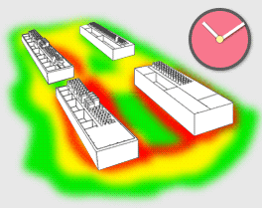
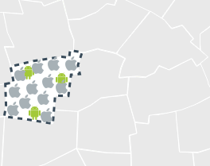
SmartMarket - Key Benefits
Location Intelligence for Business Expansion
Get an in-depth understanding of your audience demography, economic capabilities, movement pattern & much more data to identify potential locations for expansion decisions.
Leverage The Demographic Break-Up
Plan your store for the audience you want whether female or male; young or old; working or retired.
Figure Out Popular Places At Different Times
Make informed business decisions by analyzing footfall at any place for any time of the day.
Analyse The Affluence Level
Find out the spending capability of people in the designated area.
Copyright 2019 | Lepton Software

Slide 23
Telecom Data
Price range of Handset
ARPU
Gender
Age Group
Cities/ States
Subscriber type
Pincodes
Roaming Status
Employment Status
By
as part of our partnership
Demographics + Location + Affluence + Behavioral Data
Copyright 2019 | Lepton Software

Slide 24
Datasets
Landmarks & POI Dataset
Personal Navigation Aid for appropriate lane driving
Landmark & POI
Junction Views
Populace+
Demographics Data
Ongoing Infrastructure projects in India
InfraNow
Lifestyle Data
Lifestyle-Economical Behavioral Data
Access Maps
Soil Map
Data providing
information of soil type
Indoor Floor Plan maps
Datasets
eTransit Maps
Town & Village Amenity
Amenity data at Town & Village level
Public Transit for top 25 cities
Road Networks
LULC Map
Landuse-Landcover Map
Road and Railway Network Maps
Landmark 3D
Household Profile
3D Models of Landmarks & POIs
1:1K Maps
IndiaPin
Household Amenity & Asset data
Locality+
Pincode Boundaries with pinode information
House level Landbase Map @1:1,000 scale
Neighborhood boundaries map
Copyright 2019 | Lepton Software

Slide 25
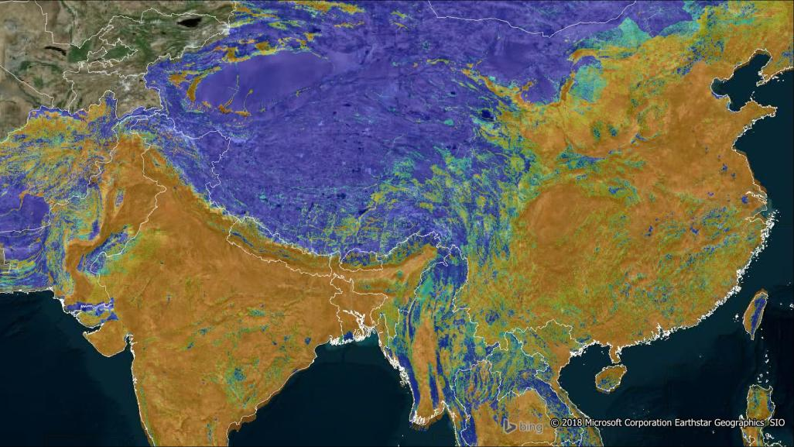
SmartData
DEMOGRAPHIC DATA
ADMINISTRATIVE
BOUNDARIES
LANDMARK & POI DATA
ROAD & RAIL NETWORKS
Copyright 2019 | Lepton Software

Slide 26
Contact Us
1. Lepton Software Export & Research (P) Ltd
570, Jwala Mill Road, Udyog Vihar, Phase-V,
Gurgaon, Haryana, INDIA Phone : +91 9953317168 | Fax : +91 124 2340104
2. Lepton Software Pte Ltd.
1#07-10, North Bridge Road, High Street Centre,
Singapore - 179094
3. Lepton Software Trading FZCO
Dubai Silicon Oasis Headquarters Building, 4th Floor,
C & D Wing, PO Box 341041, Dubai Silicon Oasis,
Dubai (UAE) | Phone: +971 502738969
4. Lepton Software Inc.
3524 Silverside Road Suite 35B,
Wilmington, DE 19810-4929, USA
Phone : +1 8455050445
Email: marketing@leptonsoftware.com

